Slide 1
WELCOME
T o O u r P r e s e n t a t i o n

Slide 2


Slide 3
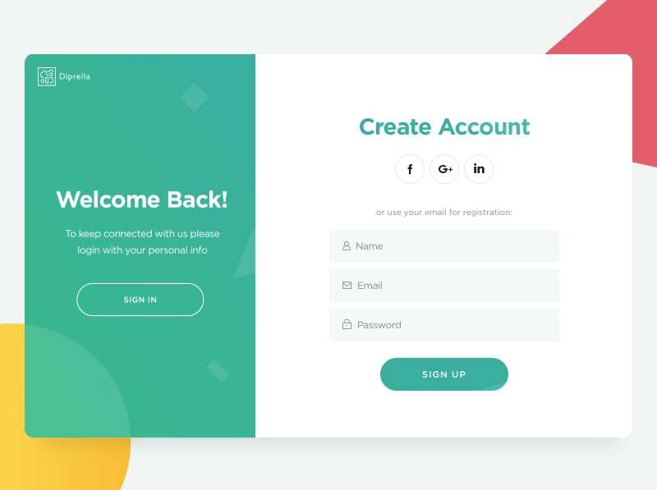


Slide 4



Our Services
Plumbing , Electrical , Lawn Services , Home Cleaning , Carpet Cleaning , Window Cleaning , Application Servicing , Pest Control , Painting , General Repair

Slide 5






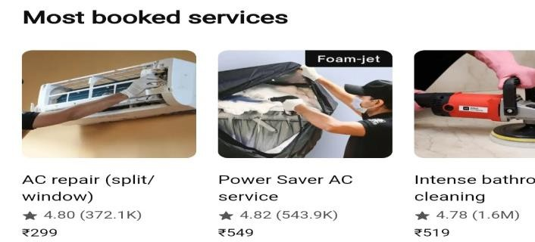


Home Page Interface

Slide 6



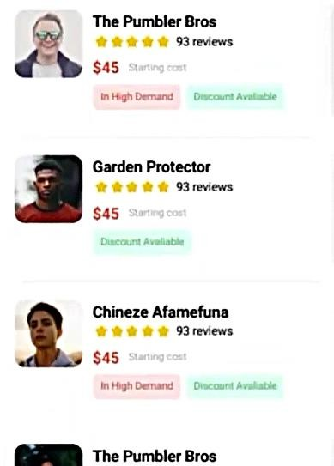
Advanced
Search & Filter
Filters
Men Women Kids

Slide 7
Real−Time Availability Check of workers.
Sr.No | Name. | Contact No. | Dept. | Status.
1. | Mr.Chagan Mishra | +91 80056 48935 | Electrical | On Duty
2. | Mr.Ayush Roy | +91 76325 68412 | Mechanical | Scheduled at 4.00PM
3. | Mr.Sunnyy Sharma | +91 75968 23458 | Plumbing | On Leave
4.
5.
6.

Slide 8


Electricians
Sr.No. | Name | Contact No.
1. | Mr.Sandip Sharma | +91 89565 75436
2. | Mr.Ram Singh | +91 76325 68412
3.
4.
5.

Slide 9
Mechanics
Sr.No. | Name | Contact No.
1. | Mr.Sunny Sharma | +91 89565 75436
2.
3.
4.
5.

Slide 10



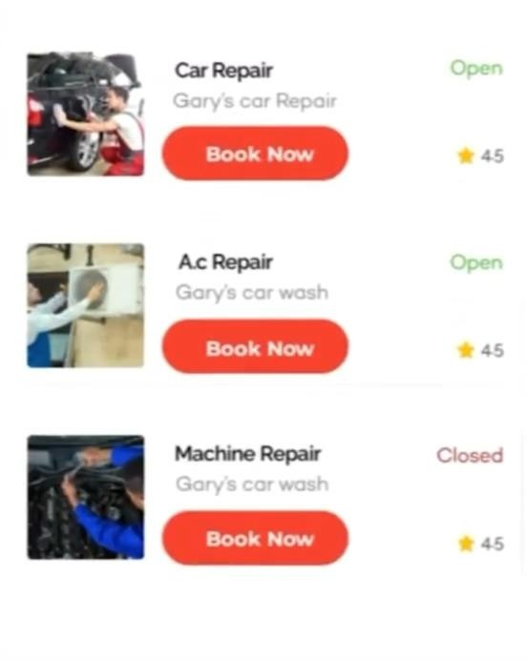
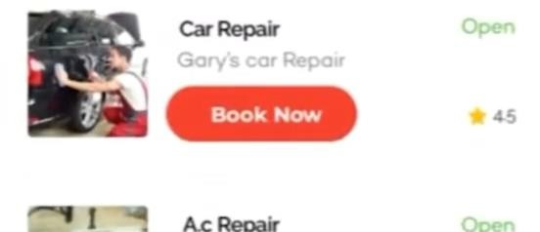

BOOK YOUR SERVICES
Price
Min
max

Slide 11

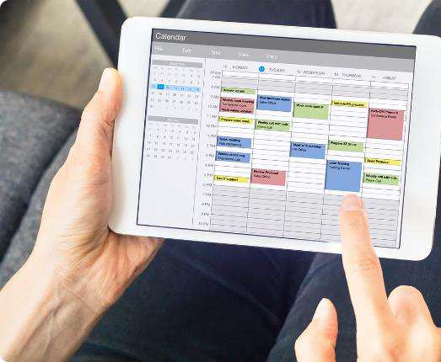
Streamline Scheduling
1
Instant Booking
Book appointments with available service providers in just a
just a few taps.
2
Flexible Scheduling
Find a time that works for you, even on nights and weekends. weekends.
3
Automated Reminders
Receive push notifications to ensure you never miss a scheduled appointment.

Slide 12

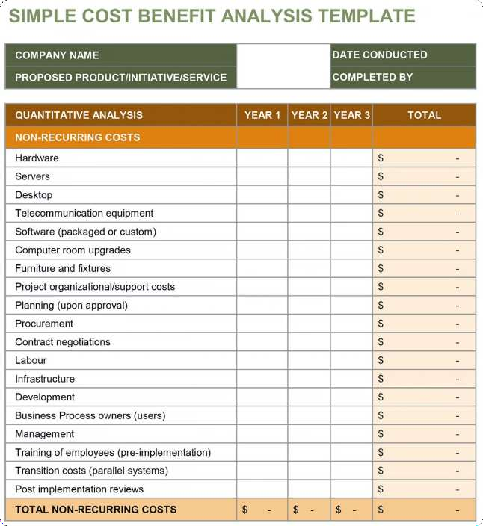
Transparent Pricing
Upfront Estimates
Get a clear
breakdown of costs before booking any service.
No Hidden Fees
The price you
see is the price
you pay − no surprises.
2
1
3
Competitive Rates
Compare prices
prices across multiple providers to find find the best value.
4
Satisfaction Guaranteed
If you're not fully
fully satisfied,
we'll work to make it right.

Slide 13


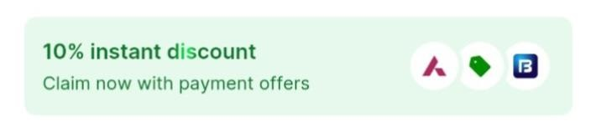
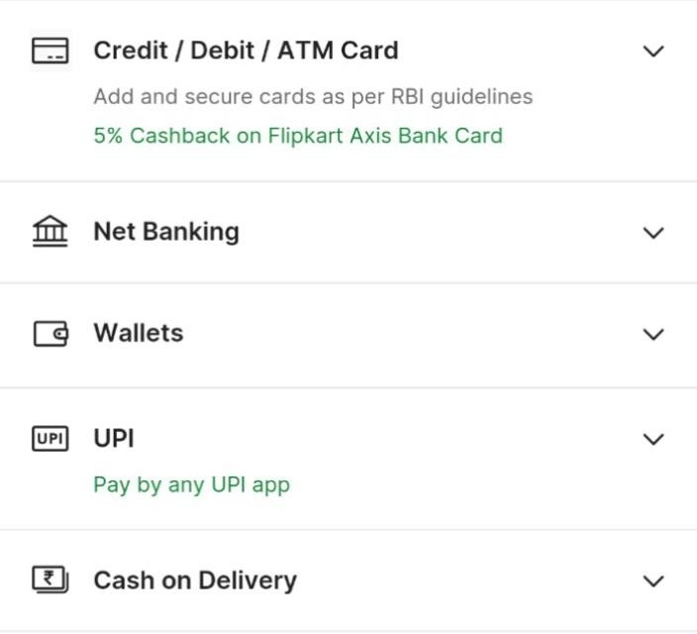
Payments
MULTIPLE PAYMENT OPTIONS

Slide 14
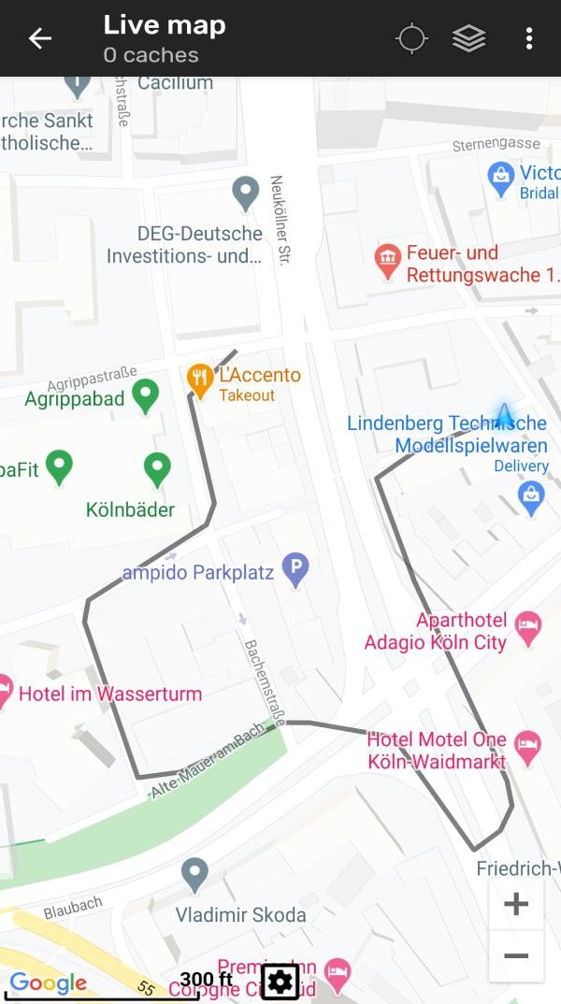
LIVE TRACKING

Slide 15
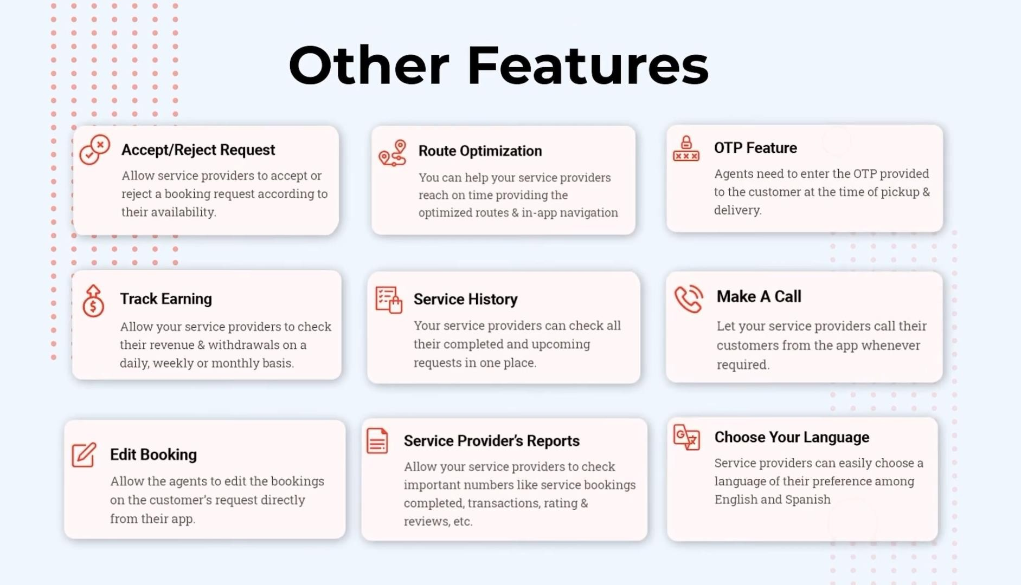

Slide 16




Dedicated Support
24/7 Assistance
In−App Messaging
Reach our friendly support team anytime, anytime, day or night.
Communicate directly with your service provider through the app.
Feedback & Disputes
Personalized Service
Share your experience and resolve any issues with our team.
We're here to ensure you have a seamless, stress−free experience.

Slide 17
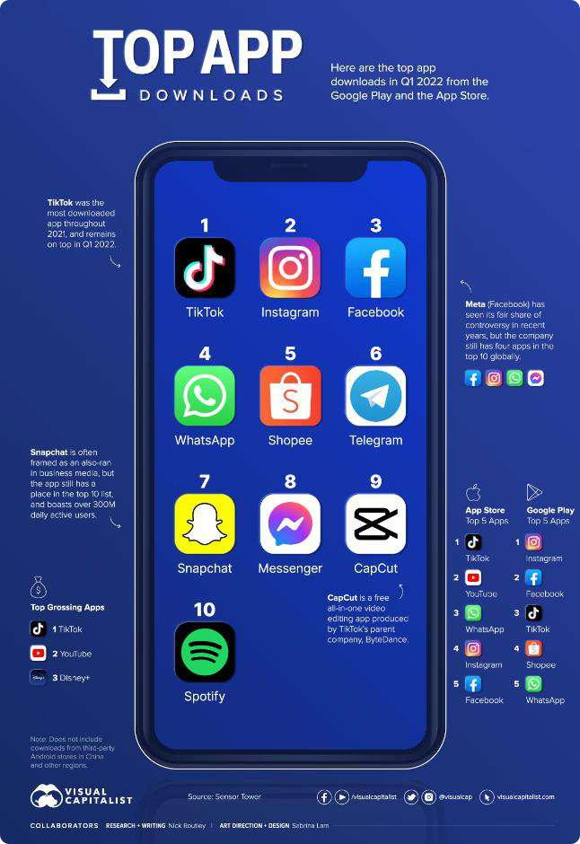
HomeService Pro
Download Now
Get the app and start connecting with reliable service providers in your area. Download for iOS or Android today or visit our website
www.Homeservicepro.com

Slide 18
&Group Name : Tech_Explorers
&Group Members :
&Ghanish Patil
&Aditya borhade
&Gaurav Tuwar
&Vedant Nagawade 5)&Saujanya Thorat
&Trupti Bornare
&Vishnu Verma
&Nagare Krishna &&2
2124UCSM1047
2124UCSM1016
2124UCSM1060
2124UCSM1048
2124UCSF1106
2124UCSF1107
2124UCSM1067
124UCSM1032

